Slide 1
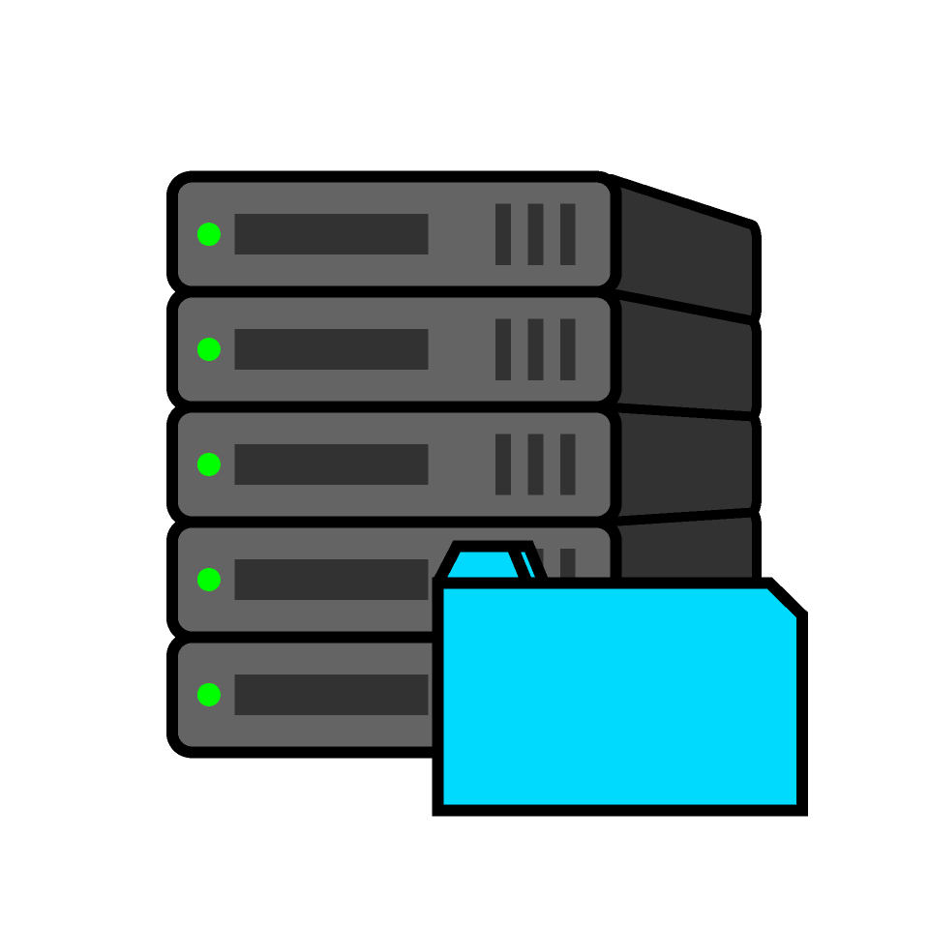

File Transfer Protocol
Using Cisco Packet Tracer
Computer network Group Project

Slide 2
Prepared By
Name : Maiyani Rahil
Name : Kanani Prayag
Enroll No. : 23002170110060
Enroll No. : 23002170110078
Roll No : 55
Roll No : 70
Branch : CE
Branch : CE
Name : Moghariya Aryankumar
Name : Mehta Keyur
Enroll No. : 23002170110094
Enroll No. : 23002170110087
Roll No. : 84
Roll No. : 77
Branch : CE
Branch : CE

Slide 3

Introduction to FTP
What is FTP?
Purpose of FTP
File Transfer Protocol (FTP) is a standard network protocol used for transferring computer files from a server to a client on a computer network.
Its primary purpose is to enable users to upload, download, and manage files on a remote server. It's crucial for web development, data backup, and sharing large files.
FTP remains a fundamental tool for networking, facilitating seamless file exchange across multiple systems.

Slide 4

Routers
Interconnect multiple LANs
Use dynamic routing (RIP v2) for communication
One core router and three access routers
Switches
Connect PCs within each department LAN
Operate at Second Layer
Network
Components
End Devices (PCs)
Represent Student, Faculty, and Admin users
Access servers using FTP and DNS
Servers
FTP servers for file sharing
DNS server for name resolution

Slide 5
Network Interconnection Design
Student, Faculty, and Admin LANs use separate IP subnets
Each LAN connects to an access router
Access routers connect to a central core router
Servers are connected directly to the core router
Each server uses a separate subnet
RIP (Routing Information Protocol) dynamically advertises all networks

Slide 6
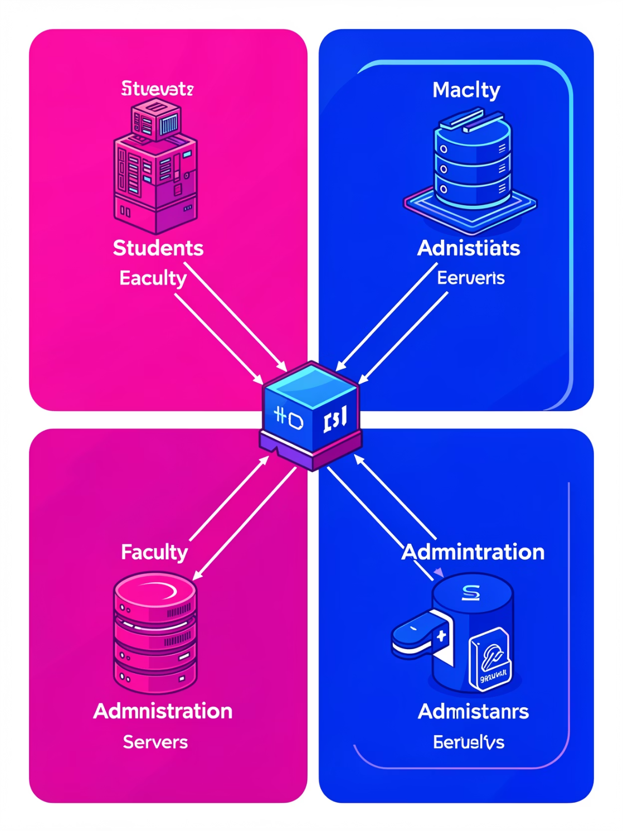
FTP in a College Network
A college network leverages FTP for various academic and administrative functions. Imagine a scenario with distinct network segments:
Student Network: (192.168.10.0) For student-related activities.
Faculty Network: (192.168.20.0) Dedicated to faculty resources.
Admin Network: (192.168.30.0) For administrative data and operations.
These networks are interconnected via a Core Router and supported by dedicated servers (Student, Faculty, Admin, and DNS).

Slide 7



FTP Use Cases in a College Setting
Student Notes Download
Students connect to the dedicated Student Server via FTP to download their materials
securely and efficiently.
Faculty File Downloads & Upload
Faculty members access the Faculty Server to download lecture materials, research papers, administrative documents and upload notes.
Admin Data Management
The Admin Network and Server enable administrators to manage sensitive institutional data,
update records, and maintain system integrity.

Slide 8

Advantages of FTP
High Efficiency
Universal Compatibility
Resume Transfers
FTP excels at transferring large files quickly and reliably.
Works across various operating systems and platforms.
Allows interrupted transfers to resume without restarting.

Slide 9

Disadvantages & Security Concerns
Disadvantages
Security Risks
Lack of Encryption: Data is transferred in plain text.
Firewall Issues: Active mode can struggle with network firewalls.
Complexity: Setting up and configuring FTP can be difficult for beginner.
Credential Theft: Plain-text credentials are vulnerable to interception.
Data Interception: Transferred files can be easily read if intercepted.
Malware Distribution: FTP servers can be exploited to distribute malicious software.

Slide 10
THANK
YOU

